Slide 1





20XX
VidConnect

Slide 2

INTRODUCTION
SHIVAM GUPTA
2200290140144
GB-28
PROJECT SUPERVISOR
DR.SHASHANK BHARDWAJ

Slide 3




Contents Table Of
PART-01
What is WebRTC
PART-02
Module 1
PART-03
Module 2
PART-04
Module 3

Slide 4

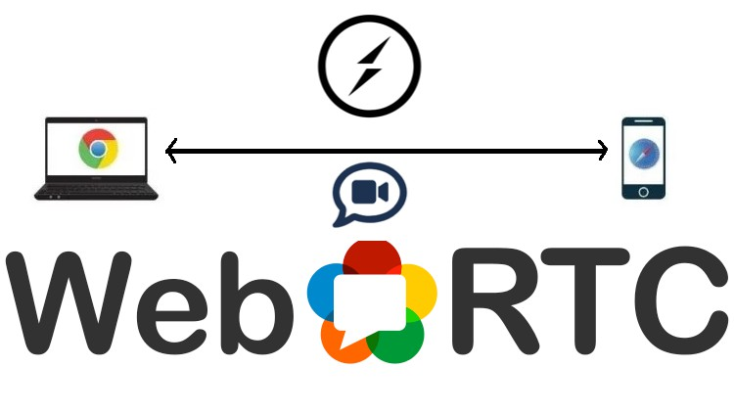
What is WebRTC
WebRTC (Web Real-Time Communication) is a powerful technology that enables real-time audio, video, and data sharing directly between web browsers and mobile applications.

Slide 5
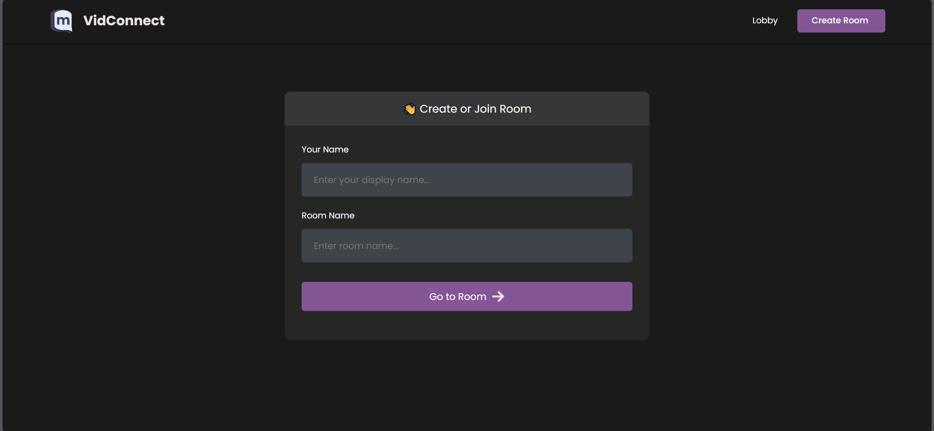

Module 1
Create or join a room

Slide 6
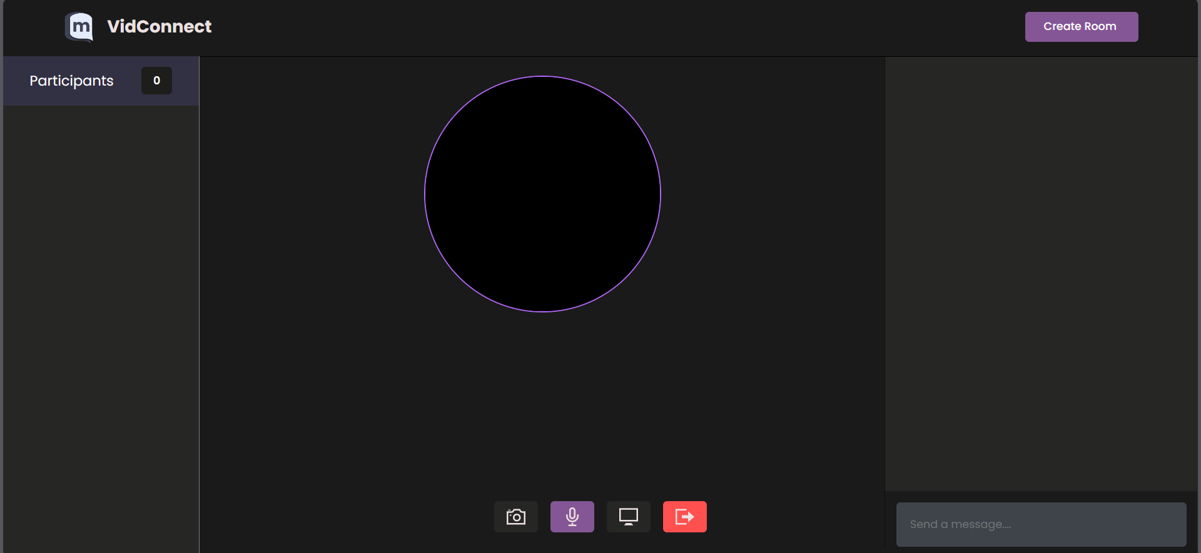

Module 2
Join Stream

Slide 7
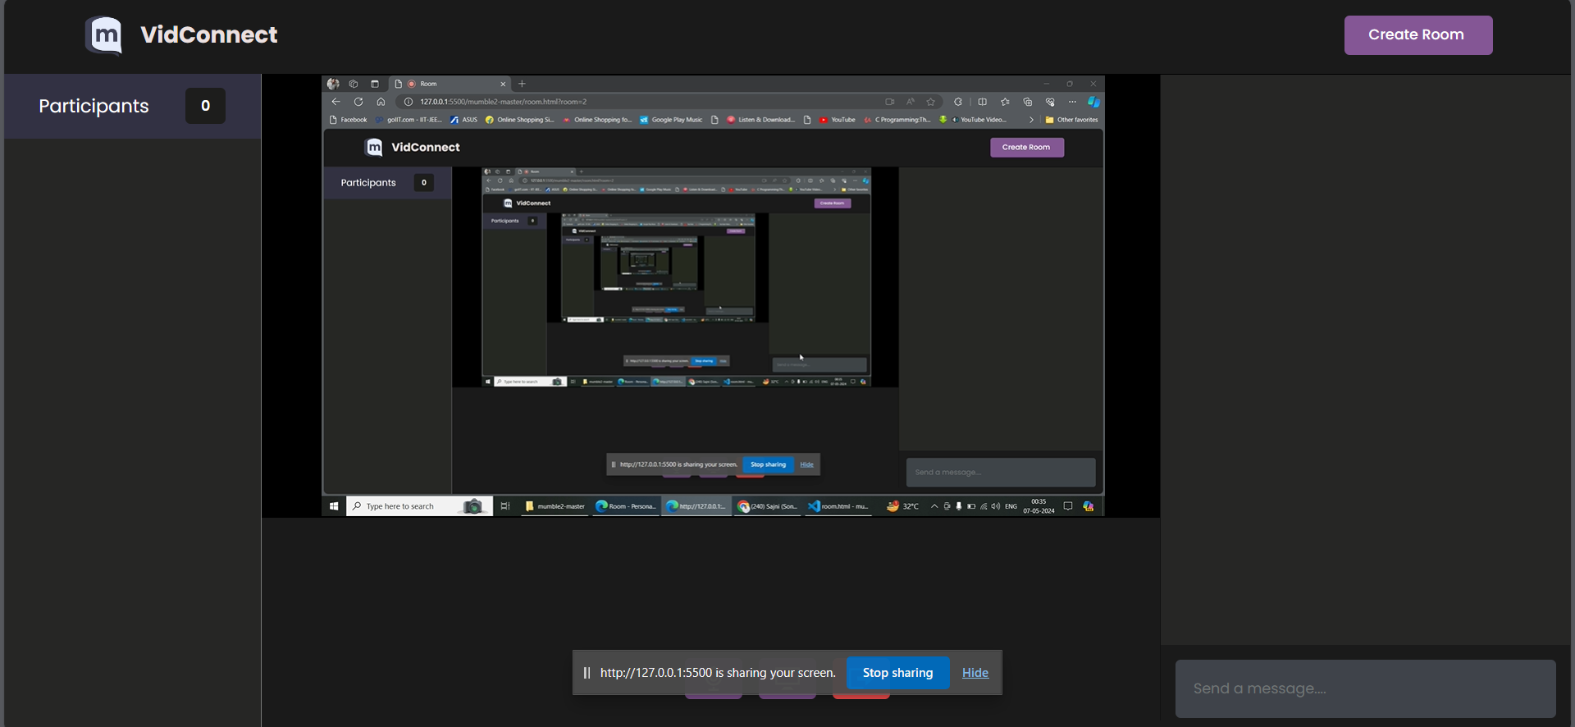

Module 3
Screen Share
Your tite here

Slide 8
THANK YOU

